Slide 1
1 meter of elevation head
1 meter
Reference elevation
1 meter of pressure head
1 meter of velocity head

Slide 2
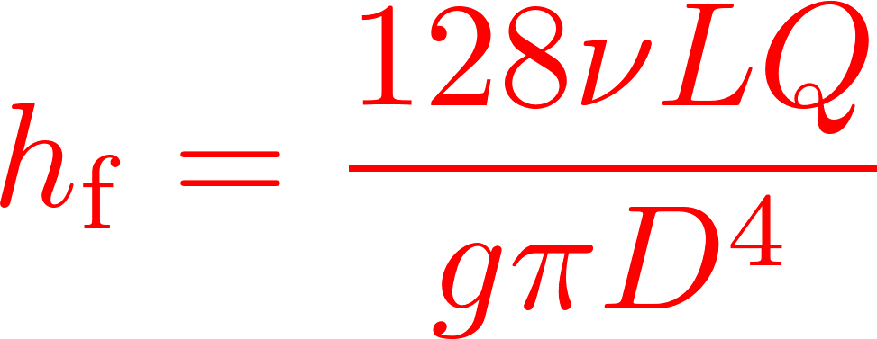


Calibrate at max flow

Slide 3
Baffles
Baffle

Slide 4
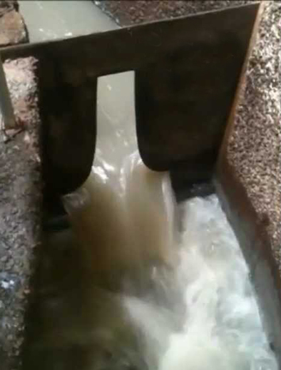
Sutro Weir
LFOM

Slide 5

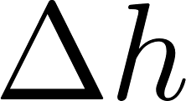




Slide 6



Slide 7


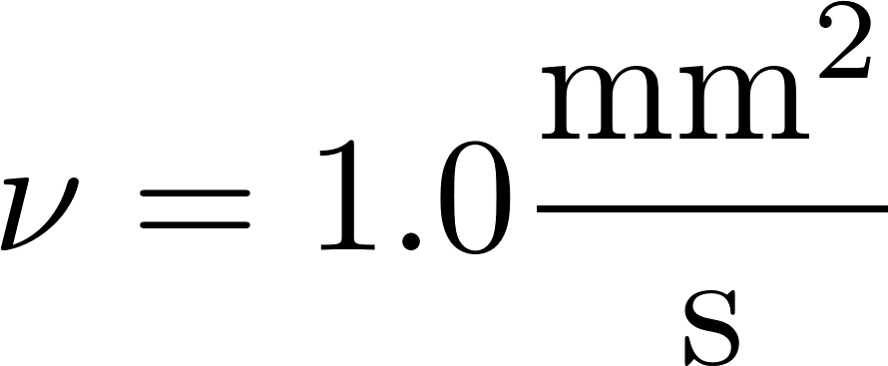




Slide 8
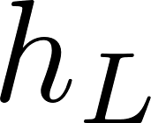
Small diameter tubing

Slide 9
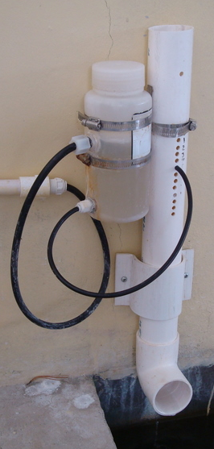
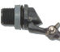
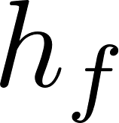
Air vent
Tube from the stock tank
Float valve
Holes to choose the dose
Flexible tube
Raw water
Rapid Mix
Orifice

Slide 10
V_{in}
V_{out}
A_{in}
x
A_{out}
in
out

Slide 11
Horizontal orifice
Vertical orifice

Slide 12
Overhead Tank
Constant head orifice
Overflow pipe
Pump

Slide 13

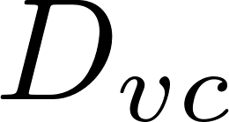
A
B

Slide 14
Pipe stub
Pipe coupling
Drain piping

Slide 15
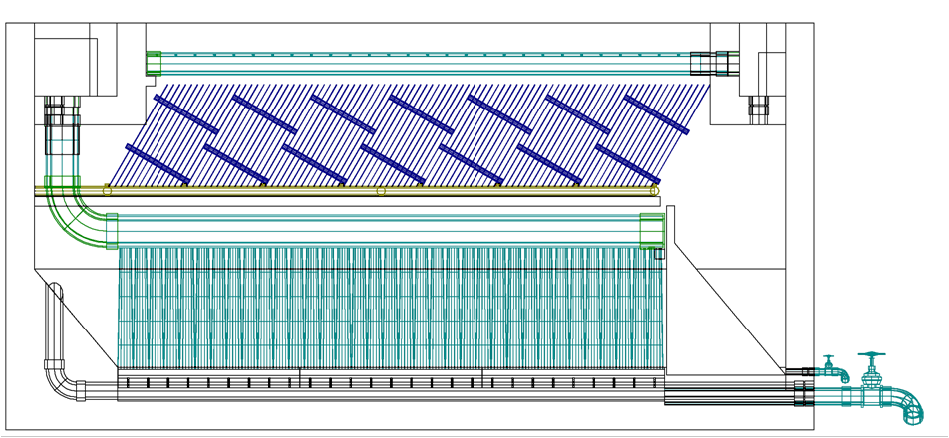
AutoCAD drawing of sedimentation tank, don’t worry if this is confusing!
You’ll learn about it in depth later on.
Sedimentation
tank drain

Slide 16


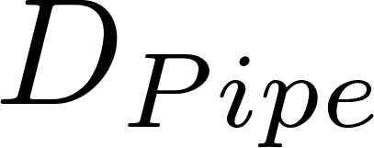


Slide 17

Float
Float
Orifice
Orifice
Transparent flexible tube
Transparent flexible tube

Slide 19
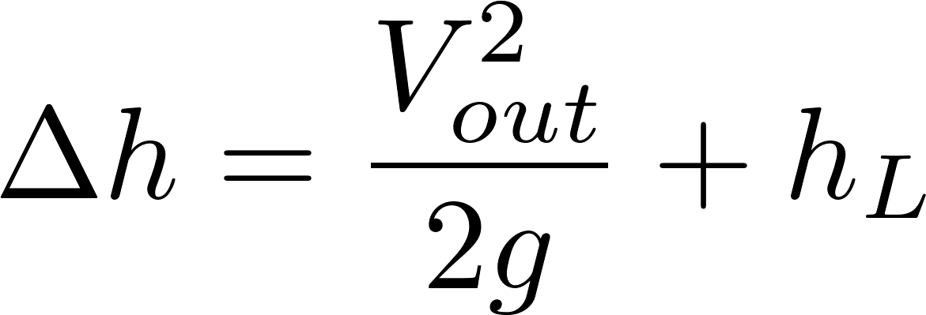






Simplified
energy equation
Just adding
K = 1 to the sum

Slide 20
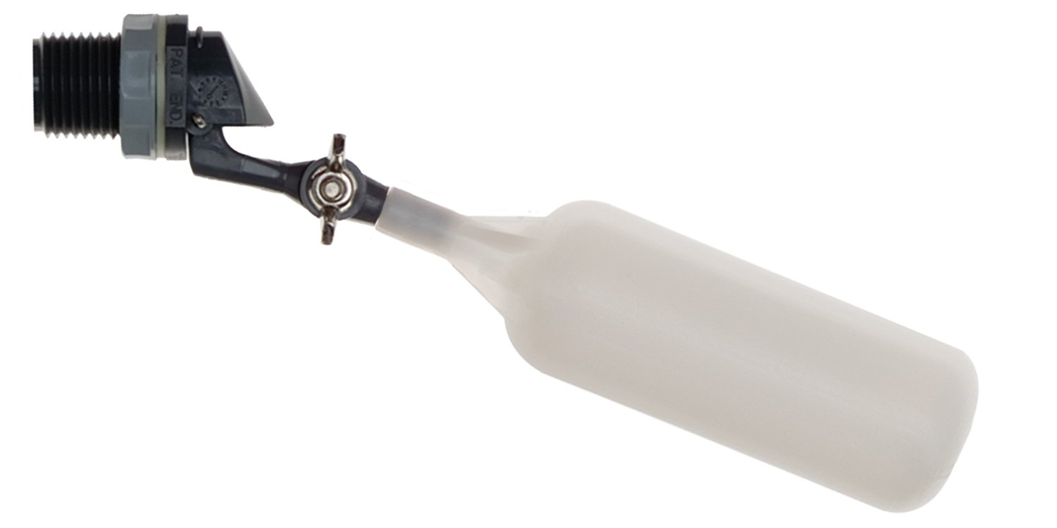
Flow of water
out of valve
Range of
motion of float
Float

Slide 21
C
B
A

Slide 22
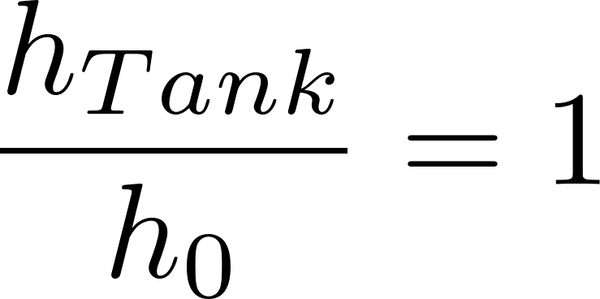
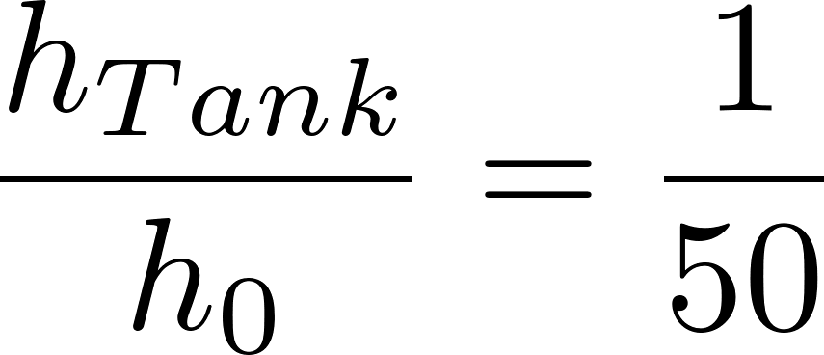
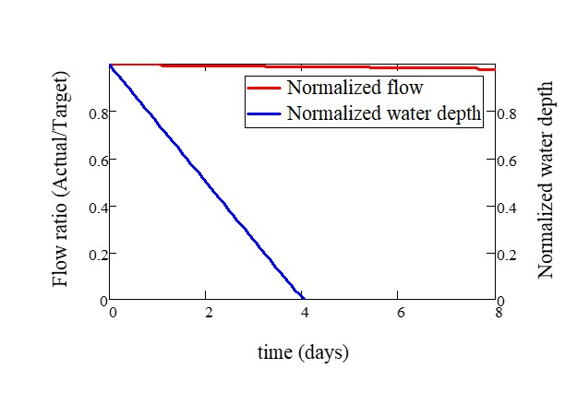
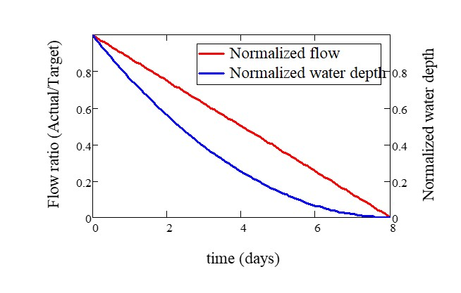

Slide 23
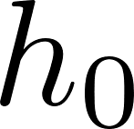
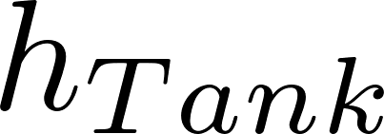
Tank
Valve
Water source pipe
Tank
Valve
Water source pipe

